Slide 1
Multi-model Emotion Recognition
— Summary of EmotiW challenges
Zheng Lian
2018-04-11

Slide 2
Contents
1. Introduction
2. Methods
3. Trend
4. Conclusion

Slide 3
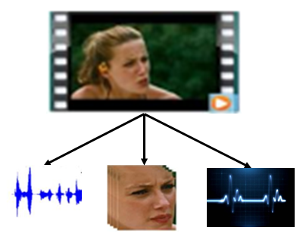
1. Introduction
Multi-model emotion recognition is a technology to identify human’s emotions by analyzing and process vocal, visual and physiological signals.
Fusion methods are essential in multi-model emotion recognition.

Slide 4
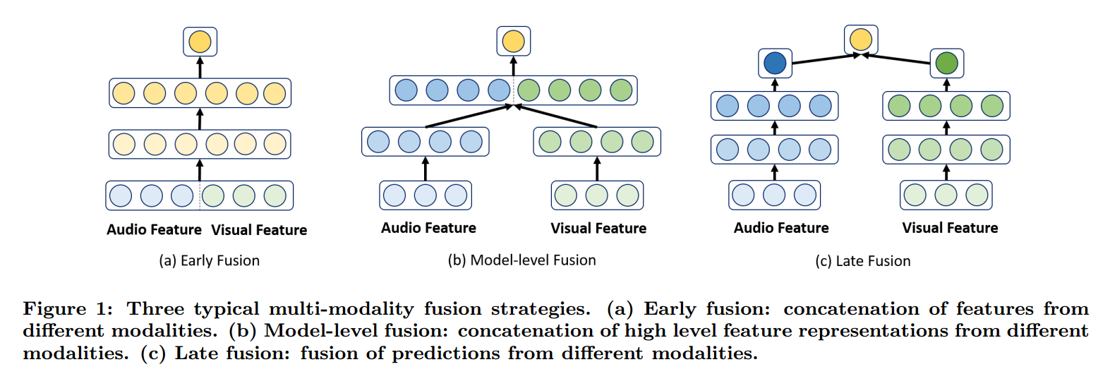
1. Introduction
Fusion methods
Early fusion
Model-level fusion
Late fusion
Chen, S., & Jin, Q. (2016). Multi-modal Conditional Attention Fusion for Dimensional Emotion Prediction. ACM Multimedia.

Slide 5
1. Introduction
Multi-model emotion recognition challenges:
(1) Dimensional emotion recognition
AVEC 2011 ~ AVEC 2017
(2) Category emotion recognition
EmotiW 2013 ~ EmotiW 2017
MEC 2016 ~ MEC 2017

Slide 6
1. Introduction
The Audio-Video Emotion Recognition sub-task of the Emotion Recognition in the Wild Challenge (EmotiW) was first organized in 2013.
Targets: Participants should assign one and only one emotion to each video clip.
The classes are usually the six basic emotions i.e., anger, disgust, fear, happiness, sadness and surprise, in addition to the neutral class.

Slide 7
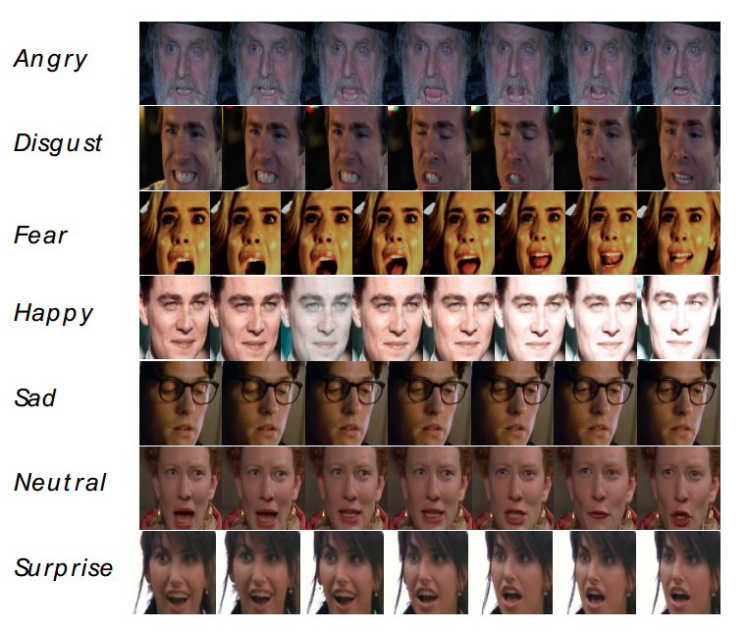
1. Introduction
Samples in the database:

Slide 8
1. Introduction
The best result in previous years.
Challenges | Accuracy (%)
EmotiW2013 | 41.03
EmotiW2014 | 50.37
EmotiW2015 | 53.80
EmotiW2016 | 59.02
EmotiW2017 | 60.34

Slide 9
2. Methods
2.1 EmotiW 2017 1st
2.2 EmotiW 2017 4th
2.3 EmotiW 2017 5th
2.4 EmotiW 2017 6th
2.5 EmotiW 2017 7th
2.6 EmotiW 2017 13th
2.7 NLPR’s methods 11th
Notes:
去年我们11名，不好呀;竞赛文章很啰嗦，没有一条很好的主线，不好讲。

Slide 10
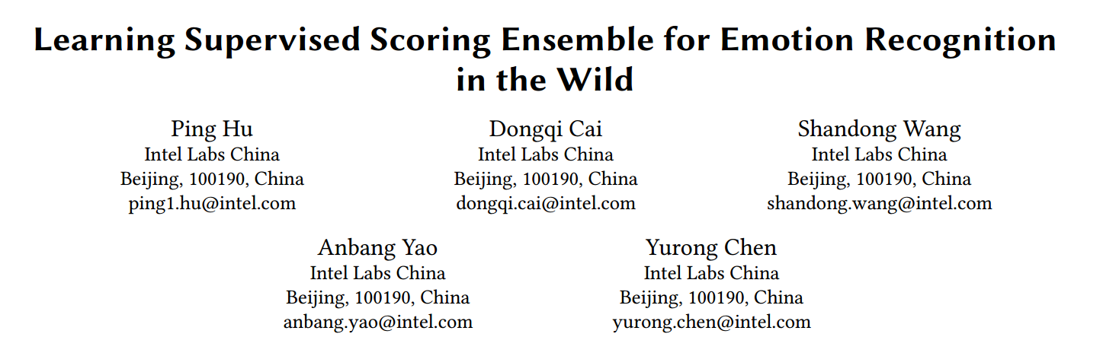
2.1 EmotiW 2017 1st
Champions —— Top performance：60.34%
Highlight: Design architectures for image classifiers without considering temporal information

Slide 11
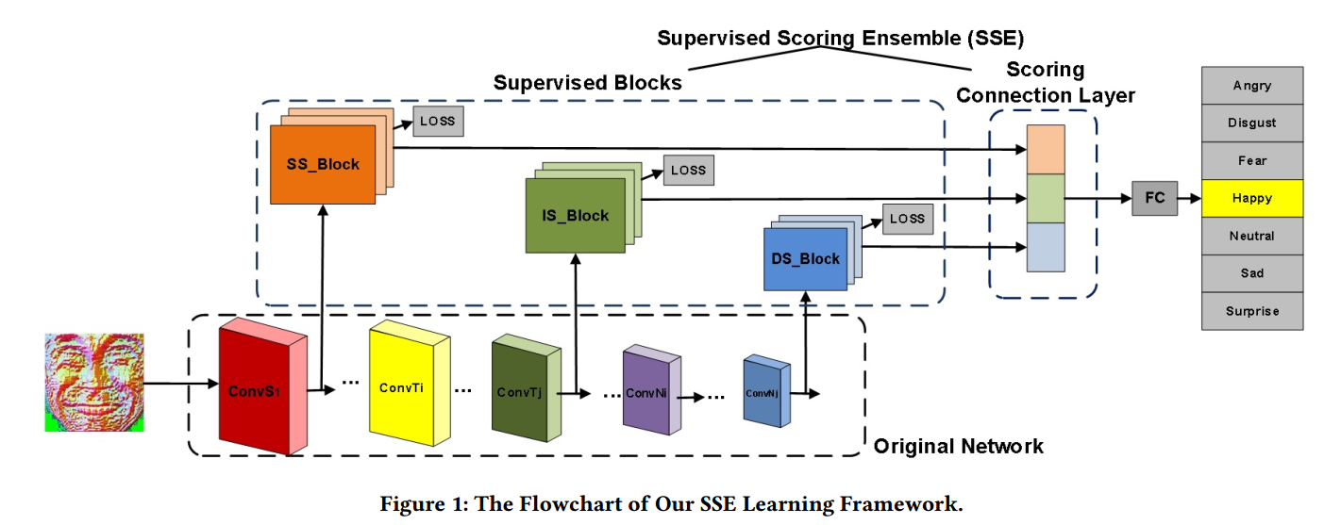
2.1 EmotiW 2017 1st
Architecture: They present a new learning method named Supervised Scoring Ensemble (SSE).
(1) Supervised Blocks (2) Scoring Connection Layer
Notes:
1、浅层、中层、深层加入监督信息
2、集成，再加入监督
（多级监督思想）

Slide 12
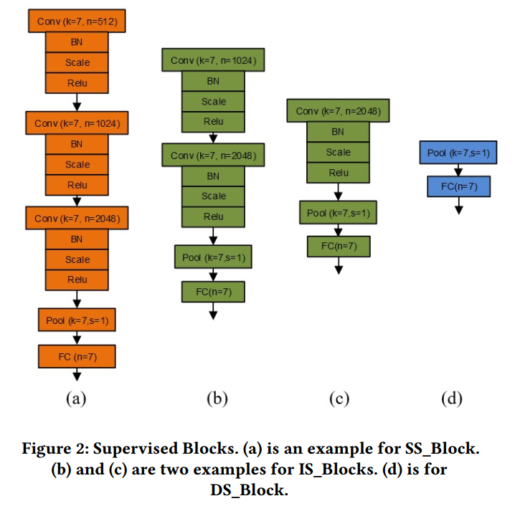
2.1 EmotiW 2017 1st
Architecture: SSE——Supervised Blocks
Notes:
Therefore, supervised blocks can be stretched out from shallow, intermediate and deep stages simultaneously.

Slide 13
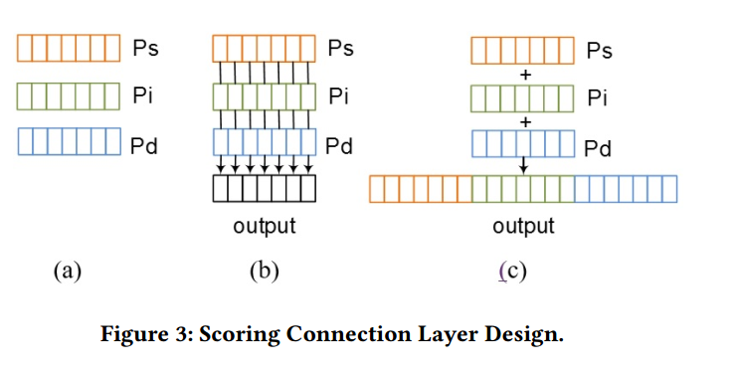
2.1 EmotiW 2017 1st
Architecture: SSE——Scoring Connection Layer
(b) Element-wise scoring connection
(c) Concatenative scoring connection

Slide 14
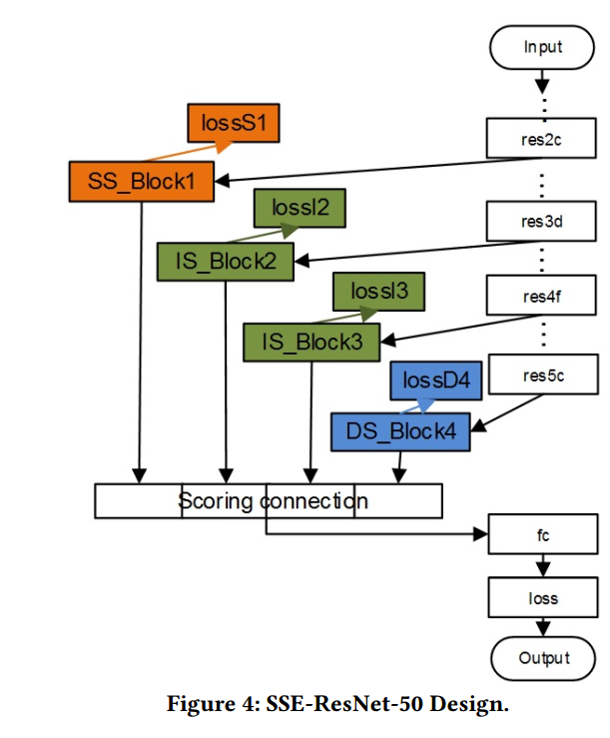
2.1 EmotiW 2017 1st
Architecture Example1: SSE-Resnet-50

Slide 15
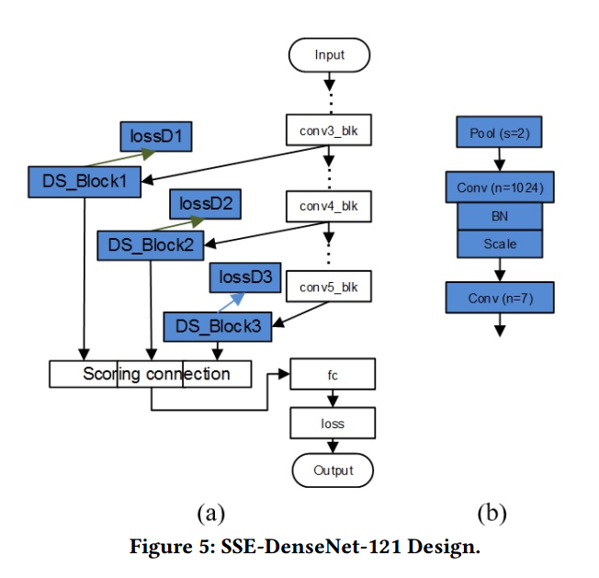
2.1 EmotiW 2017 1st
Architecture Example2: SSE-DenseNet-121

Slide 16
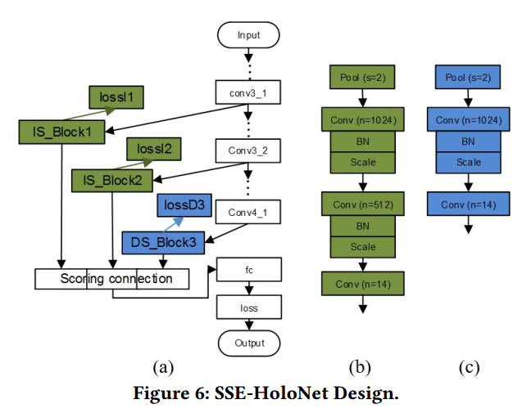
2.1 EmotiW 2017 1st
Architecture Example3: SSE-HoloNet
HoloNet: Their EmotiW2016 methods

Slide 17
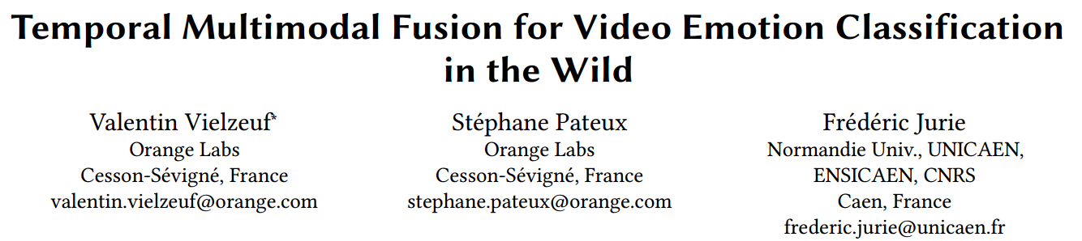
2.2 EmotiW 2017 4th
4th —— 58.80%
Highlight: EmotiW2016 champions’ method + temporal fusion(C3D-LSTM and VGG-LSTM) + multimodal fusion (majority vote, mean, ModDrop, Score Tree, Weighted mean)

Slide 18
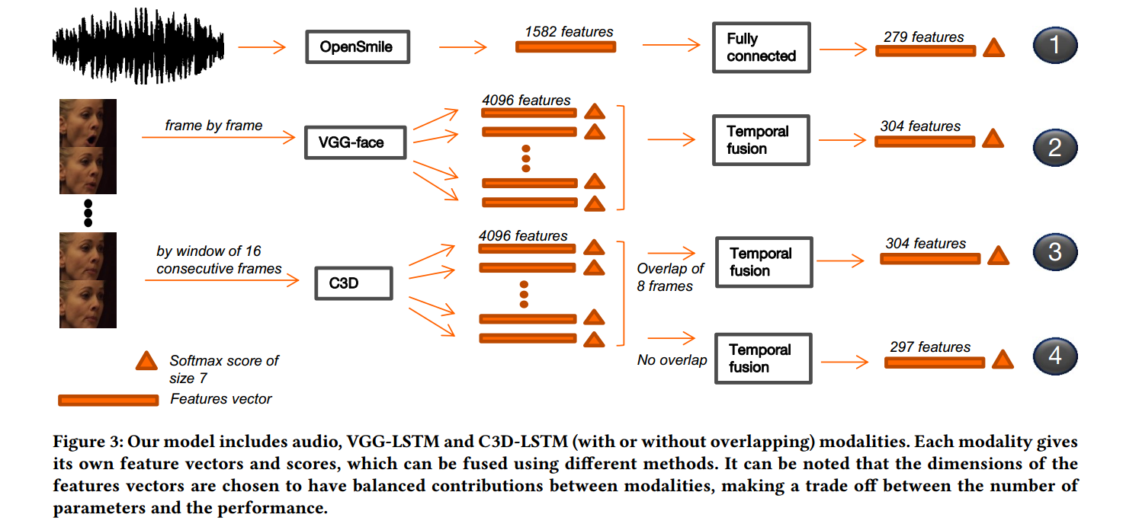
2.2 EmotiW 2017 4th
Architecture:
Notes:
Temporal Fusion: 变长LSTM
Get both scores and features
Discuss fusion
MIL 可以再看看

Slide 19
2.2 EmotiW 2017 4th
Audio Features:
OpenSMILE: emobase2010 configuration file, 1582-D features
Visual Features:
VGGFace: The images of the FER 2013 dataset [20] are first processed by detecting and aligning faces, followed with the same aligned method in the AFEW preprocessing. Then they fine-tune the VGG-face model on FER 2013 dataset.
C3D: pre-trained on ’sport1m’ and fintuned on the challenge dataset.
Notes:
Weighted C3D

Slide 20
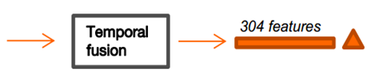
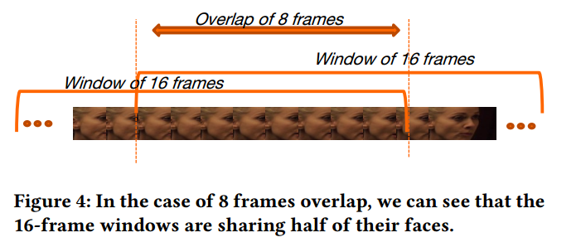
2.2 EmotiW 2017 4th
Per Modality Temporal Fusion
Variable length LSTM: VGG-LSTM and C3D-LSTM
They are used to give one description vector (output of the final fully connected layer of the LSTM) and one softmax score for each video.
C3D: overlap or non-overlap

Slide 21
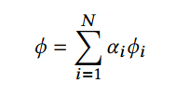
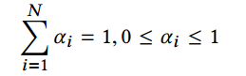
2.2 EmotiW 2017 4th
Multimodal Fusion
Baseline score fusion: “Majority vote” and “mean”
Weighted mean:
Fully connected neural network with modality drop
Score trees

Slide 22
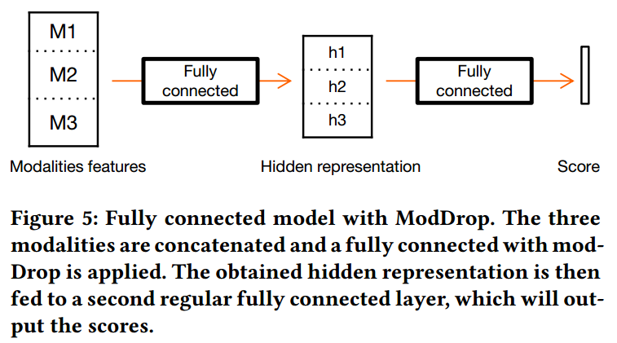
2.2 EmotiW 2017 4th
Multimodal Fusion —— Fully connected neural network with modality drop
Original paper: “ModDrop: Adaptive Multi-Modal Gesture Recognition” (TPAMI 2016)
Target: learning the cross modality correlations while keeping unimodal information.

Slide 23
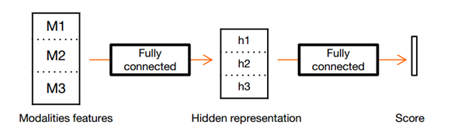
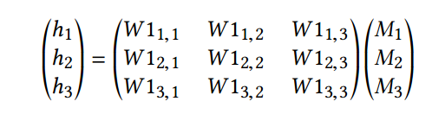
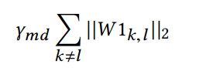
2.2 EmotiW 2017 4th
Multimodal Fusion —— Fully connected neural network with modality drop
Loss：
An important step to make convergence possible with ModDrop is to first learn the fusion without cross-modality.
Training process: γmd decreases through time.

Slide 24
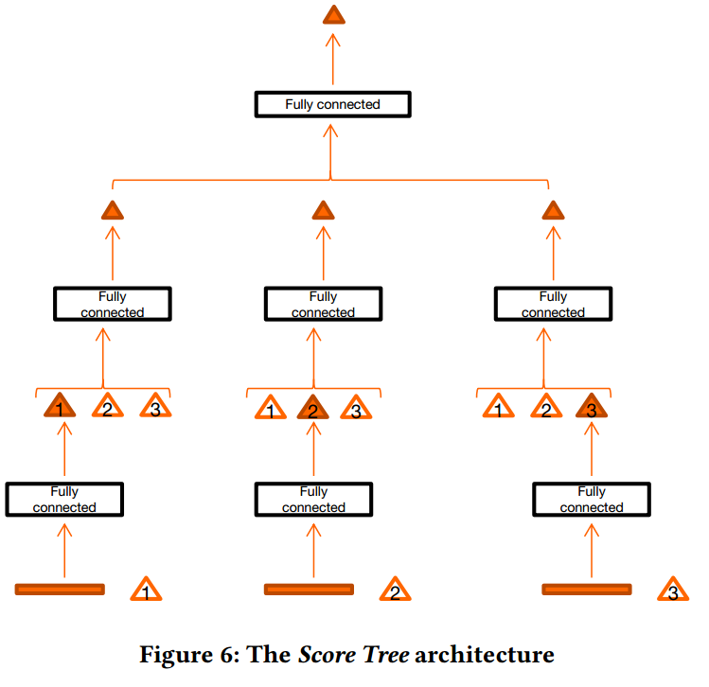

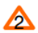
2.2 EmotiW 2017 4th
Multimodal Fusion —— Score trees
An hierarchical approach allowing to combine scores (late fusion) and features (early fusion) at diﬀerent levels.
Predict:
Original:
Notes:
Red: predict
White: original

Slide 25
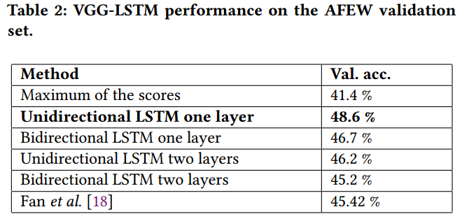
2.2 EmotiW 2017 4th
Result analysis:
VGG-LSTM: Compared with Fan et al.: Advantage of utilizing the whole sequences
Notes:
Whole sequence

Slide 26
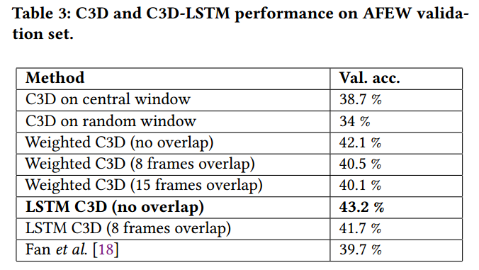
2.2 EmotiW 2017 4th
Result analysis:
C3D-LSTM: ‘Method’ refers to the ‘training method’
Audio: 36.5% (worse than 39.8% [in “Spatiotemporal Networks for Video Emotion Recognition”]), which shows that NN is worse than SVM.
Notes:
Advantage of utilizing the whole sequences

Slide 27
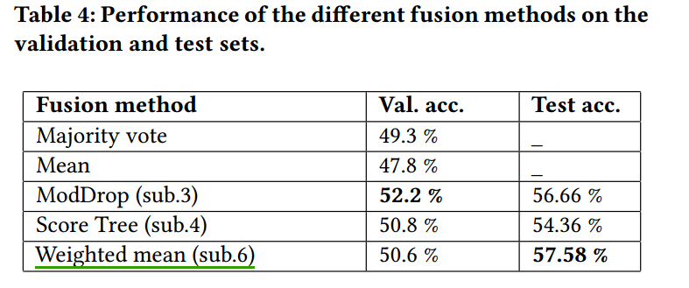
2.2 EmotiW 2017 4th
Result analysis:
Weighted mean is still the best fusion method according to the Test accuracy. (Note: less parameters are better)
Good performance on the validation set is not a warranty to good performance on the test set.

Slide 28
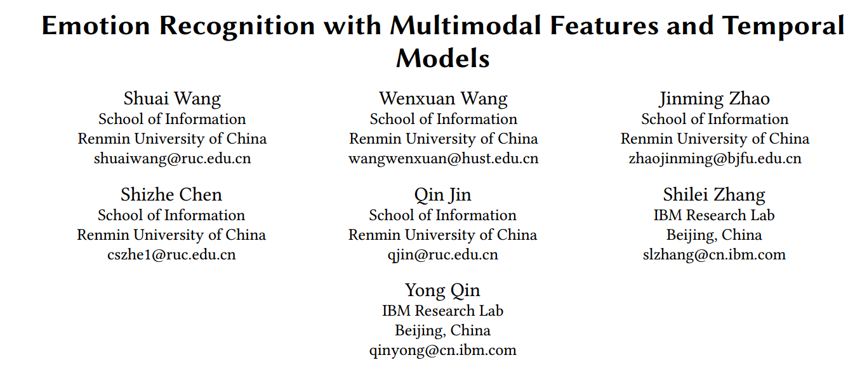
2.3 EmotiW 2017 5th
5th —— 58.50%
Highlight: frame-level features -> video-level features (BoAW, FV, VLAD), followed with their AVEC 2017 paper.

Slide 29
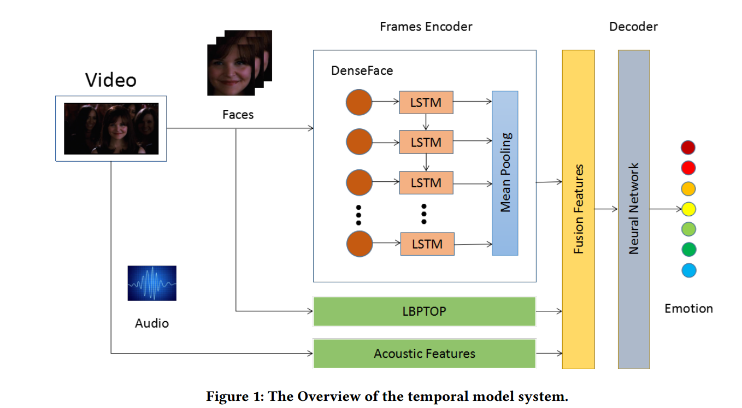
2.3 EmotiW 2017 5th
Architecture:

Slide 30
2.3 EmotiW 2017 5th
Acoustic features
Frame-level Acoustic Features: IS10 and MFCCs
Utterance-level feature encoding: Bag-of-Audio-Words(BoAW), Fisher Vector(FV) and VLAD
Facial features
Training methods: They train CNN-based models on FER+ and fine-tune the trained network on the AFEW dataset. When fine-tuning the facial expression models, they use the prediction of trained networks as the face label. The facial salient features are extracted from the fine-tuned networks.
VGGFace: ‘pool4’, ‘fc5’, ‘fc6’
DenseFace: the last mean pooling layer
LBPTOP

Slide 31
2.3 EmotiW 2017 5th
Models
Non-Temporal Models: SVM, RF, LR, NN (they use an one-layer network with 128 hidden units). "balanced" mode is utilized.
Temporal Models: LSTM (an one-layer LSTM and average the time-step outputs as the video representation)
Fusion methods
Early fusion

Slide 32
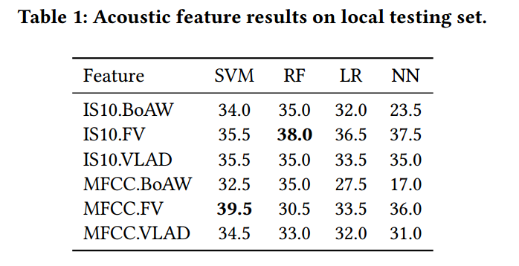
2.3 EmotiW 2017 5th
Result analysis:
The FV strategy performs better than others.

Slide 33
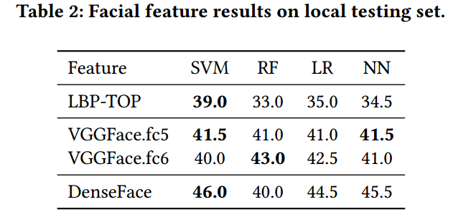
2.3 EmotiW 2017 5th
Result analysis:
The deep learned features (VGGFace and DenseFace) are more eﬀective than the hand-crafted LBP-TOP features.

Slide 34
2.3 EmotiW 2017 5th
Bag-of-Features(BoF) for text
Each word is independent from the others.
Codebook: all existing words
BoF: Calculate frequency for each word
Bag-of-Features(BoF) for image
1. Feature extraction (like SIFT)
2. Codebook : cluster center of K-Means
3. BoF: Calculate frequency for each cluster center
Notes:
忽略语法、语句
Generate codebook, generate features.特征维度和码本长度相同。统计patch出现在码本中的直方图。

Slide 35
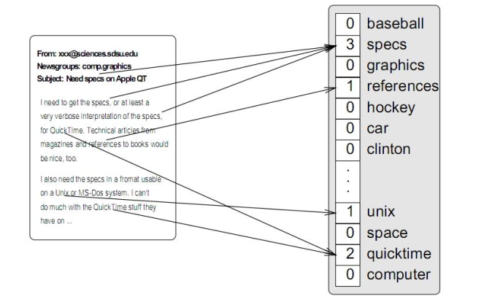
2.3 EmotiW 2017 5th
Bag-of-Features(BoF) for text
Notes:
Generate codebook, generate features.特征维度和码本长度相同。统计patch出现在码本中的直方图。

Slide 36
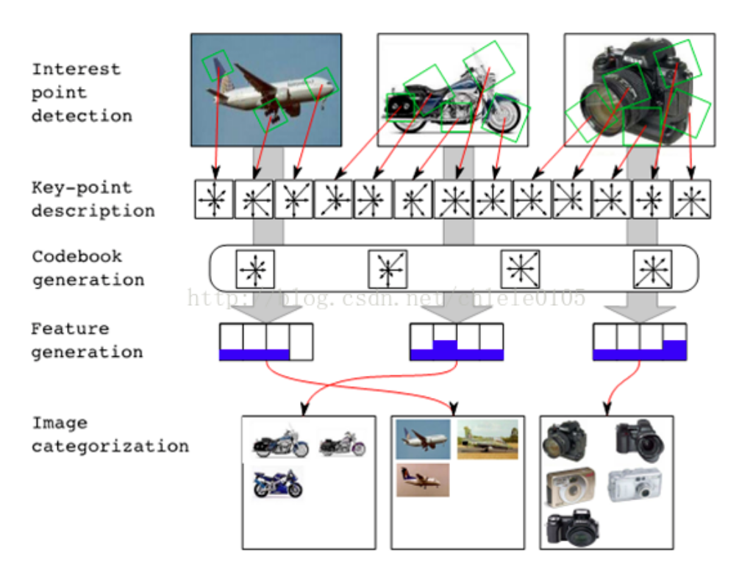
2.3 EmotiW 2017 5th
Bag-of-Features(BoF) for image
Kinnunen, Teemu et al. “Bag-of-Features Codebook Generation by Self-Organisation.” WSOM (2009).
Notes:
Generate codebook, generate features.特征维度和码本长度相同。统计patch出现在码本中的直方图。
对于时序特征集，也是一样的处理，首先提取帧级别特征，聚类，生成马奔，然后统计频率，得到句子级别特征。

Slide 37
2.3 EmotiW 2017 5th
Bag-of-Features(BoF) for utterance-level feature encoding
Frame-level features
codebook
Utterance-level features
Notes:
Generate codebook, generate features.特征维度和码本长度相同。统计patch出现在码本中的直方图。
对于时序特征集，也是一样的处理，首先提取帧级别特征，聚类，生成马奔，然后统计频率，得到句子级别特征。

Slide 38
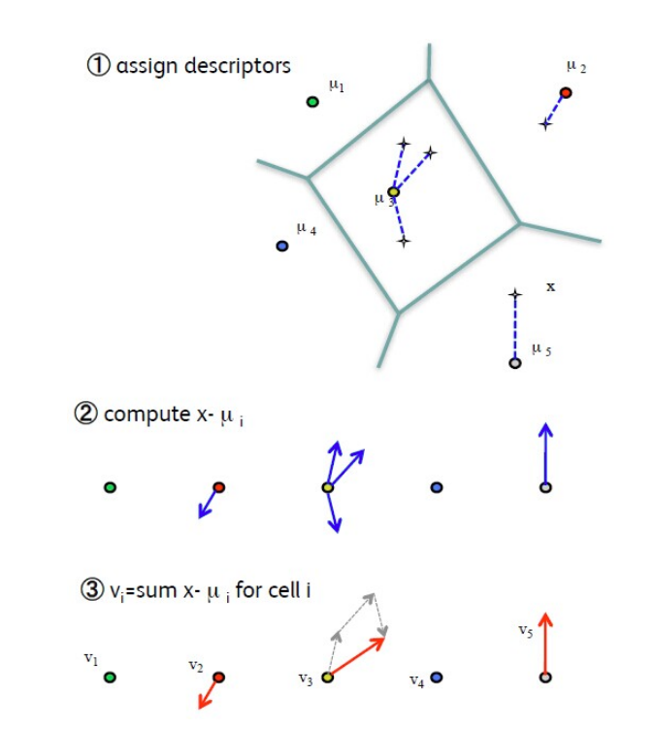
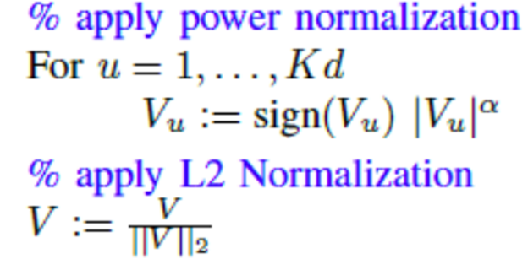
2.3 EmotiW 2017 5th
VLAD

Slide 39
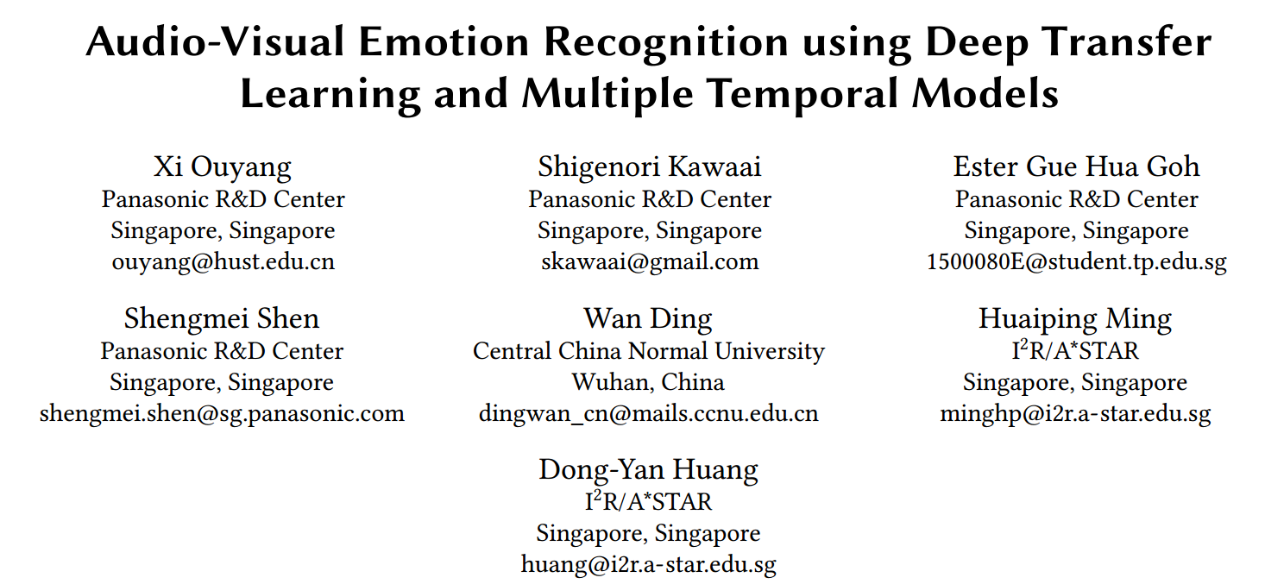
2.4 EmotiW 2017 6th
6th —— 57.20%
Highlight: EmotiW 2016 + end-to-end video emotion recognition + transfer learning for the audio classifier

Slide 40
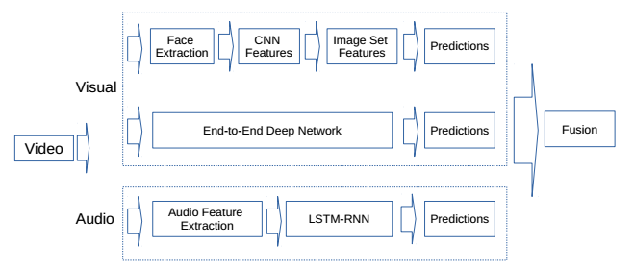
2.4 EmotiW 2017 6th
Architecture:
Notes:
Imageset: EmotiW 2016

Slide 41
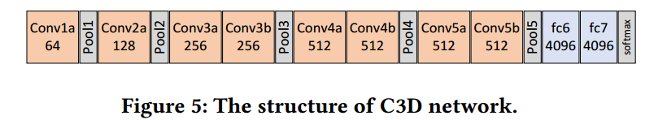
2.4 EmotiW 2017 6th
First branch: ImageSet model
Their EmotiW2016 methods
Ding, W., Xu, M., Huang, D., Lin, W., Dong, M., Yu, X., & Li, H. (2016). Audio and face video emotion recognition in the wild using deep neural networks and small datasets. ICMI.
Second branch: End-to-end deep network
C3D
VGG-LSTM
Resnet-LSTM (Approach for Face Recognition in ECCV2016)

Slide 42
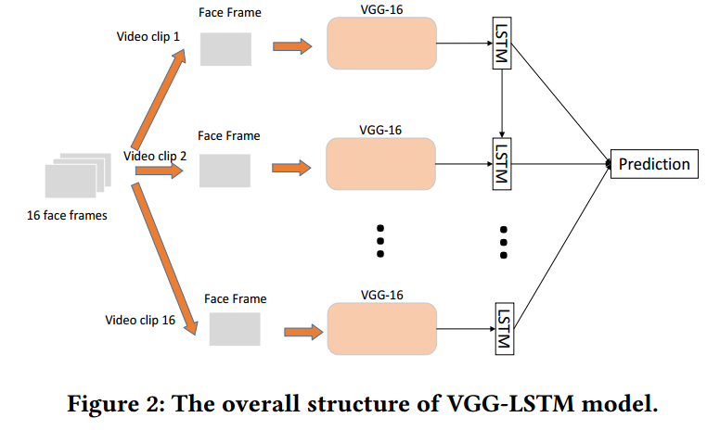
2.4 EmotiW 2017 6th
VGG-LSTM
VGG16 is transferred from VGGFace.

Slide 43
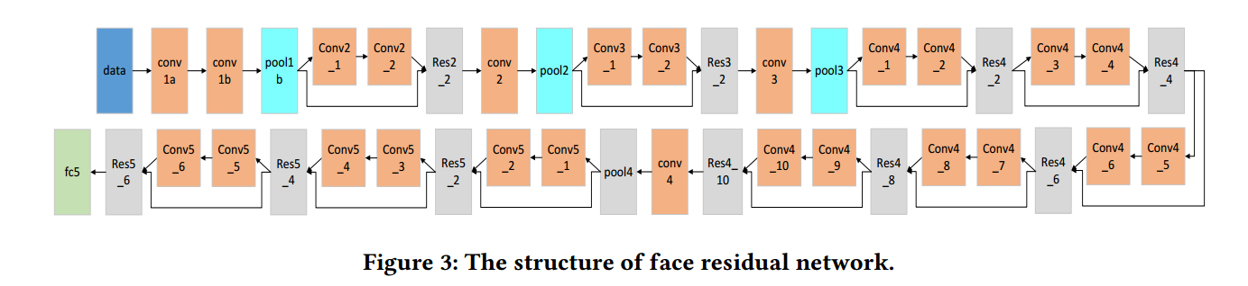
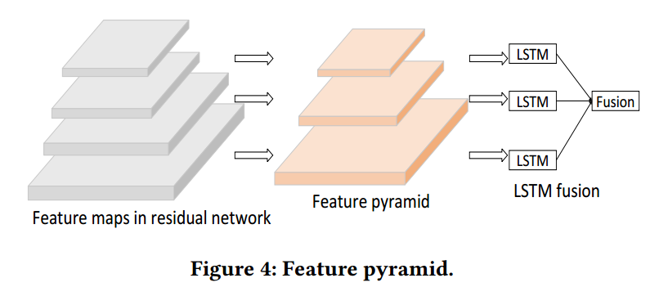
2.4 EmotiW 2017 6th
Resnet-LSTM(also called Pyramid CNN-LSTM)
Three one hidden layer LSTMs with 128 nodes took the outputs of CNN layers respectively and the final output is the element wise sum of three LSTMs.

Slide 44
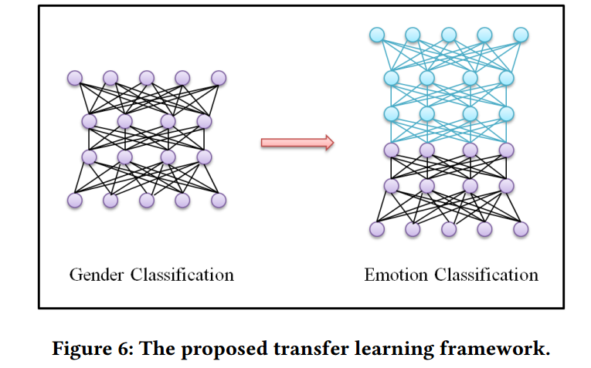
2.4 EmotiW 2017 6th
Third branch: Audio emotion recognition
Transfer learning: Gender classification -> emotion classification
Features: eGemaps
The gender classifier is trained on LibriSpeech.

Slide 45
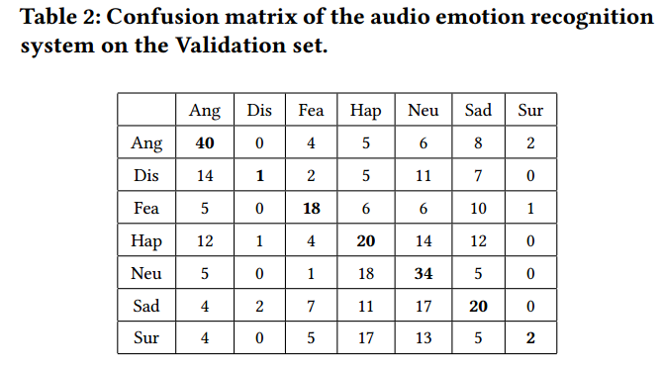
2.4 EmotiW 2017 6th
Result analysis
Audio: The average accuracy is 35.2%

Slide 46
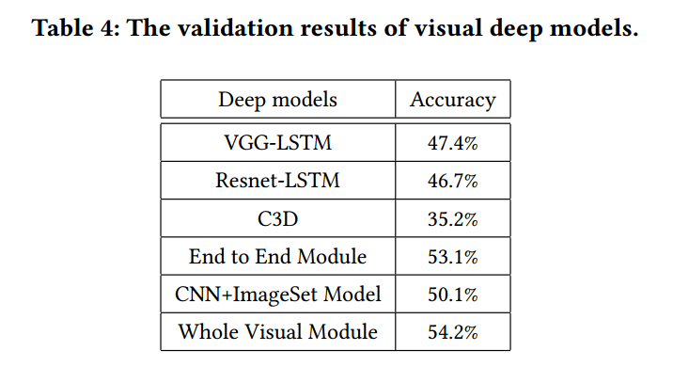
2.4 EmotiW 2017 6th
Result analysis
Video: VGG-LSTM architecture achieves better performances than more free architectures such as Pyramid CNN-LSTM and C3D.

Slide 47
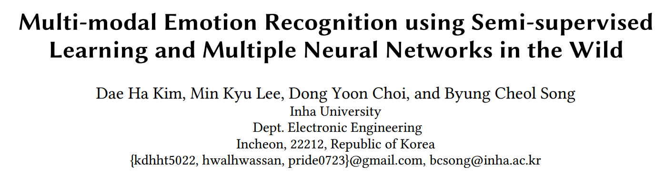
2.5 EmotiW 2017 7th
7th —— 57.12%
Highlight: landmark-based networks and multiple methods to overcome overfitting problems of C3D.

Slide 48
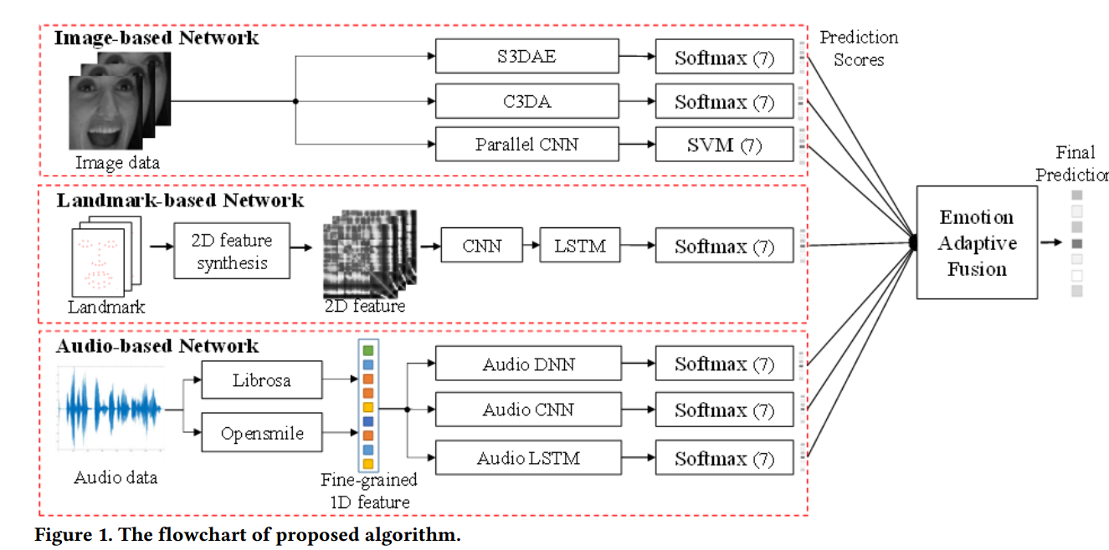
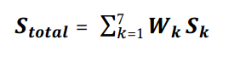
2.5 EmotiW 2017 7th
Architecture:

Slide 49
2.5 EmotiW 2017 7th
Image-based recognizer: (C3D has overfitting problems)
Semi-supervised Learning with 3D Autoencoder(S3DAE)
Convolutional 3D with Auxiliary Network (C3DA)
Parallel CNN Network
Landmark-based recognizer:
2D Landmark Feature Transformation + CNN-LSTM
Audio-based network
Audio-CNN
Audio-DNN
Audio-LSTM

Slide 50
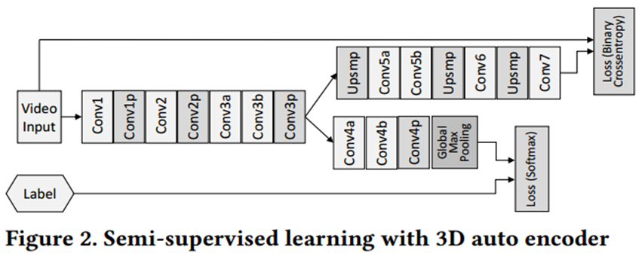
2.5 EmotiW 2017 7th
Image-based recognizer——S3DAE
3DAE: combine the temporal information into traditional AE.
3DAE plays a role of assisting the main network learning because it gives weight initialization effect.
Semi-supervised 3DAE: add label during training

Slide 51
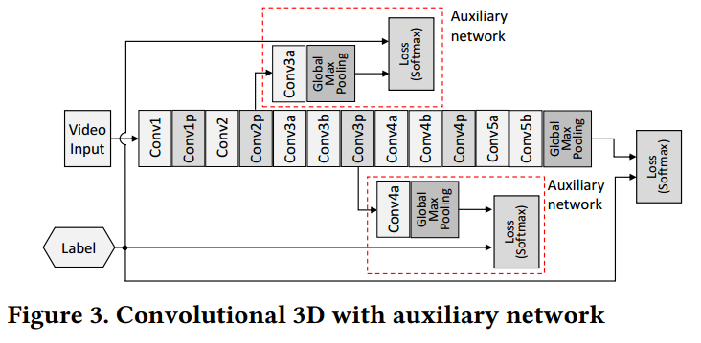
2.5 EmotiW 2017 7th
Image-based recognizer——C3DA
Reference: GoogleNet
Auxiliary network: mitigate vanishing gradient problems
The down-sampling process of the image is replaced by 2-stride convolution in 3D max pooling. The existing FC layer is replaced with the global pooling

Slide 52
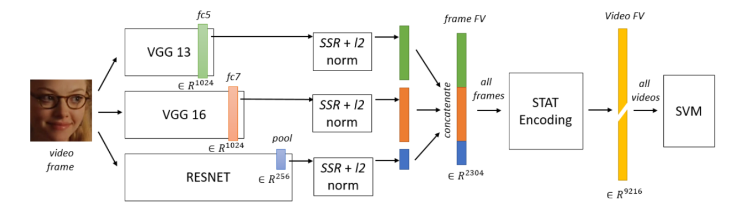
2.5 EmotiW 2017 7th
Image-based recognizer——Parallel CNN Network
R- VGG13 (R: residual connection)
R- VGG16 (R: residual connection)
Wide Residual Network (WRN)
Xception
Statistic functions
Bargal, Sarah Adel et al. “Emotion recognition in the wild from videos using images.” ICMI (2016).

Slide 53
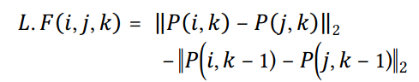
2.5 EmotiW 2017 7th
Landmark-based recognizer:
2D Landmark Feature Transformation: Convert the landmark position information of a target face into a 2D image feature
CNN-LSTM: Consider temporal information

Slide 54
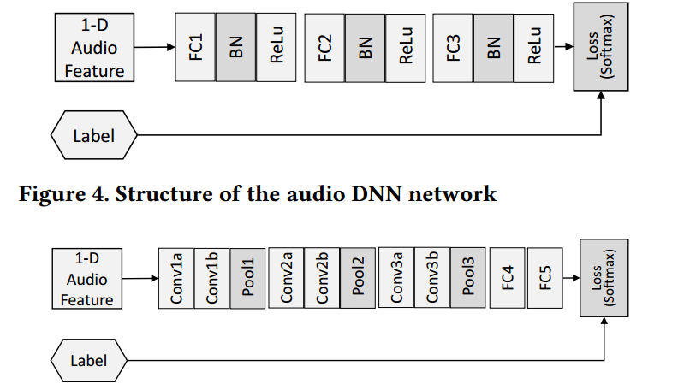
2.5 EmotiW 2017 7th
Audio-based network
Audio-CNN : (utterance-level)
Audio-DNN: (utterance-level)
Audio-LSTM: (frame-level)

Slide 55

2.5 EmotiW 2017 7th
Result analysis:

Slide 56

2.6 EmotiW 2017 13th
13th —— 49.92%
Highlight: frame-level features -> video-level features through trainable NetVLAD layers

Slide 57

2.6 EmotiW 2017 13th
Architecture:
fixed
trainable
Pre-trained
Trained from scratch
Notes:
音频数据: LSTM对最后时刻编码

Slide 58
2.6 EmotiW 2017 13th
Features:
FaceNet branch : captures a set of visual features representing the face
Source code: https://github.com/davidsandberg/facenet
Parameters in ‘FaceNet’ are fixed.
conv2D and FC are pre-trained on FER2013.
C3D branch: jointly captures visual and motion information
Source code: https://github.com/facebook/C3D
Parameters in ‘C3D’ are fixed.
conv2D and FC are pre-trained on the challenge dataset
SoundNet branch
Source code: https://github.com/cvondrick/soundnet
Parameters in ‘SoundNet ’ are fixed.
conv1D and LSTM are pre-trained on the challenge dataset and the eNTERFACE dataset.

Slide 59
2.6 EmotiW 2017 13th
Feature Aggregation:
FaceNet branch: NetVLAD, aggregated representation for 48 frames
C3D branch: NetVLAD, aggregated representation for 32 motion features
SoundNet branch: no aggregation, only take one second in the middle of the video

Slide 60


2.6 EmotiW 2017 13th
Training:
Two phases: Three branches are trained separately. Then the multi-modal fusion network is trained using the trained branches.
Loss function: the standard and weighted loss function are as follows.
Targets of weighted loss function: increase the importance of the most frequent classes and reduce the importance of the less frequent ones.

Slide 61

2.6 EmotiW 2017 13th
Result analysis:
‘Average’: The prediction of every video is obtained averaging the predictions of its frames.
Multi-modal fusion is essential.

Slide 62


2.6 EmotiW 2017 13th
Feature Aggregation: NetVLAD (CVPR2016)
Home Page: http://www.di.ens.fr/willow/research/netvlad
NetVLAD is a Trainable VLAD, whose cluster centers can be learned.
Arandjelovic, Relja et al. “NetVLAD: CNN Architecture for Weakly Supervised Place Recognition.” 2016 IEEE Conference on Computer Vision and Pattern Recognition (CVPR)(2016): 5297-5307.

Slide 63

2.7 NLPR’s methods
解决方法：特征+分类器+融合策略

Slide 64
2.7 NLPR’s methods
解决方法——特征
音频特征：包括两个特征集合：GEMAPS和eGemaps。本工作还基于语音识别系统，对每一帧抽取了瓶颈特征。
视频特征：主要包括LBP-TOP特征。本工作还基于训练好的CNNs模型，抽取每帧图片的瓶颈特征。
解决方法——分类器
句子级别分类器： SVM、随机森林、Xgboost等。
帧级别分类器：本工作比较了多种神经网络分类器

Slide 65





2.7 NLPR’s methods
解决方法——分类器
帧级别分类器
(a)
(b)
(c)
(d)
(e)

Slide 66
2.7 NLPR’s methods
解决方法——融合策略
参数融合（Parameter Fusion）：对于不同的预测结果，采用一个固定系数加权
稠密融合（Dense Fusion）：不仅考虑了相同类别预测结果之间的影响，同时考虑了不同类别预测结果之间的影响
分级融合（Hierarchical Fusion）：参数融合+稠密融合。

Slide 67
2.7 NLPR’s methods
实验结果:
音频特征分类：随机森林适用于音频情感分类。
视频特征分类
特征 | 准确率（%）
GEMAPS | 33.16
eGEMAPS | 33.76
Audio_English_Features | 33.94
Audio_Chinese_Features | 36.91
分类器 | 准确率(%)
句子级别分类器 | 38.38
帧级别分类器 | 39.16
Notes:
同时语音识别的瓶颈特征要优于传统特征集。

Slide 68
2.7 NLPR’s methods
实验结果:
融合策略：分级融合具有一定的优势。
虽然验证集上提升明显，但是过拟合现象严重。
 | 概率集合，融合方式 | 验证集准确率（%） | 测试集准确率（%）
1 | Selection 1, Parameter Fusion | 50.39 | 45.02
2 | Selection 1, Dense Fusion | 53.26 | 44.87
3 | Selection 2, Dense Fusion | 52.48
4 | Selection 3, Dense Fusion | 55.09 | 47.47
5 | Selection 4, Dense Fusion | 54.83
6 | 1+2+3+4+Hierarchical Fusion | 57.96 | 48.70
7 | 1+2+3+4+5+Hierarchical Fusion | 58.49 | 48.85
8 | 1+2+3+4+5+Hierarchical Fusion + cv | 62.52 | 51.15

Slide 69
3 Trend
Year-Rank | Feature | Classifier | Fusion Method | Highlight
2014-1 | HOG, Dense SIFT, DCNN, Audio | Kernel SVM, LR, PLS | Late fusion | Riemannian Manifold
2014-2 | SIFT BOW, PHOG, LBP-TOP, LPQ-TOP, Audio | SVM | Hierarchical classifier fusion (Late fusion), MKL (feature fusion) | Hierarchical classifier fusion
2014-3 | HOG-TOP, Audio | SVM | MKL | HOG-TOP
2014-4 | Inner face, Audio | ELM | ELM | ELM

Slide 70
3 Trend
Year-Rank | Feature | Classifier | Fusion Method | Highlight
2015-1 | AU-aware facial feature, CNN, Audio | SVM | Late fusion | AU-aware feature
2015-2 | (Frame feature: SIFT, HOG, LPQ, LBP, LGBP) + (Function: TOP, FUN, FV), Audio | PLS, ELM | Late fusion | GPA based alignment
2015-3 | CNN-IRNN, Aggregated CNN, Audio, Activity | MLP | MLP | CNN-RNN
2015-4 | SIFT BOW, LBP-TOP, Audio | PLS | Late fusion
2015-5 | SPM LBP-TOP, SIFT BOW, CNN, Audio | SVM | softmax | SPM, softmax

Slide 71
3 Trend
Year-Rank | Feature | Classifier | Fusion Method | Highlight
2016-1 | CNN-LSTM, C3D, Audio | SVM | Late fusion | CNN-LSTM, C3D
2016-2 | HoloNet, Audio, iDT | SVM | Late fusion | HoloNet
2016-3 | CNN-BRNN, AU-aware, Audio | SVM, CNN | Late fusion | CNN-BRNN
2016-3 | (Image: CNN) + (Function: STAT) | SVM | Feature level fusion | CNN

Slide 72
3 Trend
Year-Rank | Feature | Classifier | Fusion Method | Highlight
2017-1 | image, audio | Image: softmax; Audio: SVM | Late fusion | SSE
2017-2 | 2016-1, C3D-LSTM, VGG-LSTM, audio | Softmax | Multiple fusion methods: score Tree, ModDrop | Fusion methods
2017-3 | DenseFace, VGGFace, LBPTOP, MFCCs, IS10 | SVM, RF, softmax | Early fusion | Utterance-level encoding: FV, VLAD, BoAW
2017-4 | VGG-LSTM, Resnet-LSTM, C3D, audio | softmax | Late fusion(Reinforcement learning) | end-to-end video features
2017-5 | C3DA, S3DAE, Parallel CNN, landmark-based features, multi-CNN for audios | softmax | Late fusion | landmark-based networks, multi-C3D
2017-6 | FaceNet, C3D, SoundNet | softmax | Model level fusion | NetVLAD

Slide 73
4 Conclusion
Feature-level conclusion:
Before 2016, many handcraft features were utilized. HOG, LBP, LPQ and SIFT are the most common features. Those features are always combined with TOP, FUN, SPM and BOF method to take the temporal information into account.
Now the deep neural networks generate many state-of-the-art performances in many fields. Many handcraft features are replaced by DNNs features in emotion recognition. Architecture like CNN-BLSTM is wildly utilized.
Multi-modal fusion conclusion:
The most common fusion method is past EmotiW challenge is the late fusion.

Slide 74
4 Conclusion
How to aggregate frame-level information into video-level information?
Statistic Functions , VLAD, BoF, FV, NetVLAD, LSTM
How many frames can represent a video?
Random 16 consecutive frames, 40 frames, 48 frames, all frames
How to generate end-to-end spatial-temporal representation?
CNN-LSTM, C3D, C3D-LSTM
How to alleviate overfitting problems?
Model level (less trainable parameters and simple architecture), data level(more data with correlated annotation methods)
What other information should be considered?
Scene description, ASR results, movie type, speaker-age, speaker-gender

Slide 75
Thanks！
Q&A

